Slide 1

Exploring the Potential Contributing Factors to Diabetes
Presented by:
Saudia Epps
Kolton Ascheman
Nathan Trnka
Marsha Cole
February 14, 2024

Slide 2
Introduction
Diabetes represents a significant global health challenge, with its prevalence steadily increasing. In the United States, over 133 million individuals are affected by either diabetes (37.3 million) or prediabetes (96 million) (CDC, 2022).
This escalating burden highlights the importance of understanding the contributing factors to Type 2 Diabetes; hence, our exploratory data analysis focused on the following:
What are some of the trends between contributing factors?
How many diabetics do not have any of the illnesses/behaviors?
Is there a combination of factors that tend to correlate with a diagnosis of diabetes?

Slide 3
Data Source and Collection
Data was sourced from the Diabetes Prediction Dataset (by Mohammed Mustafa) via Kaggle.
It is a collection of medical and demographic data from patients and their diabetes status (positive or negative).
The dataset consisted of 100,000 entries across nine variables: gender, age, hypertension, heart disease, smoking history, body mass index (BMI), glycated hemoglobin (HbA1c) level, blood glucose level, and diabetes status.
Notes:
Hemoglobin A1C or HbA1c test—is a simple blood test that measures your average blood sugar levels over the past 3 months.

Slide 4
Data Cleaning and Preparation
The dataset was imported from the provided CSV file and stored in a new variable for analysis. Data cleaning and preparation included:
Replacing the numeric Boolean values (1, 0) with more interpretable True/False values.
Limiting the scope of the study to adults aged 21 years and above.
Removing patients whose smoking history was labeled as ‘ever.’
Eliminating rows with null values in essential variables.
Post-cleaning, the dataset had 73,978 rows. Further filtering was then applied to isolate individuals who reported having diabetes, resulting in a subset of 7,913 individuals.

Slide 5
Data Analysis Methods
Summary statistics were calculated for continuous variables.
For categorical variables, percentages were used to show the distribution of each category within the sample.
Graphs (bar charts, scatter plots, and box plots) were employed to visualize the distribution of diabetes status across different variables.

Slide 6
Gender and Smoking History
Among the individuals in the dataset, approximately one-tenth (10.7%) reported having diabetes. Gender breakdown of diabetics:
53% identified as female
47% identified as male
A significant amount (42%) reported never smoking, whereas:
20% were former smokers
12% were current smokers
26% had no reported smoking history

Slide 7
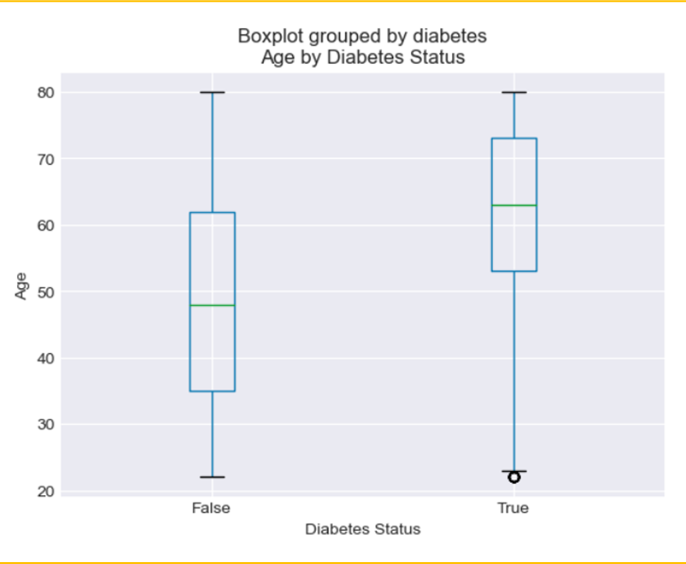
Age by Diabetes Status
Average age for the diabetics was 61.7 years (SD = 13.55), and 49.4 years (SD = 16.87) for non-diabetics.
The majority (88%) of those who reported having diabetes were aged 45 years and older.
Quartiles and outliers for Age - Diabetes:
Lower quartile: 53.0
Upper quartile: 73.0
Interquartile Range: 20.0
Median: 63.0
Values below 23.0 could be outliers
Values above 103.0 could be outliers
Figure 1: Box plot showing age by diabetes status

Slide 8
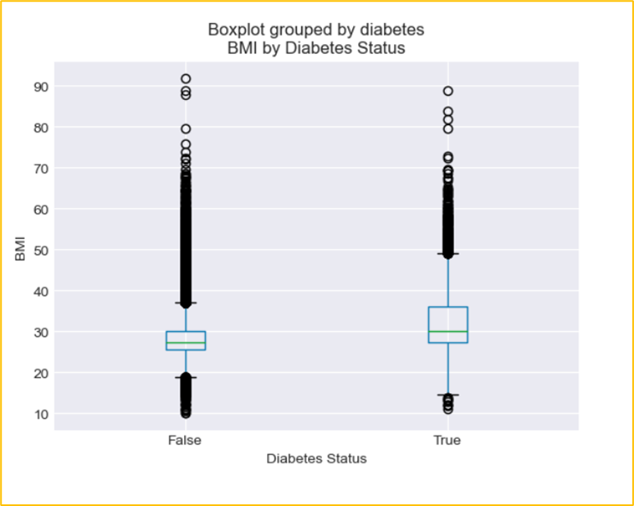
BMI by Diabetes Status
Average BMI for those with diabetes was 32.12 kg/m² and 28.39 kg/m² for non-diabetics.
A significant proportion of those with diabetes were overweight (40%) or obese (50%).
Quartiles and outliers for BMI - Diabetes:
Lower quartile: 27.32
Upper quartile: 36.01
Interquartile Range: 8.69
Median: 30.06
Values below 14.29 could be outliers
Values above 49.04 could be outliers
Figure 2: Boxplot showing BMI by Diabetes status

Slide 9
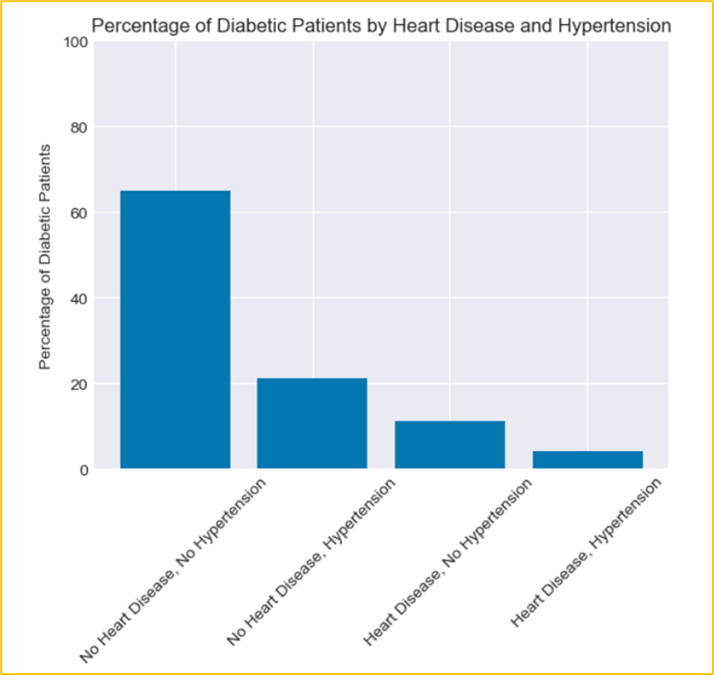
Heart Disease and Hypertension
The majority (65%) of diabetics did not have heart disease or hypertension.
21% have hypertension but no heart disease.
1o% have heart disease but no hypertension.
4% have both hypertension and heart disease.
Figure 3: Bar chart showing percentage of diabetics by heart disease
and hypertension

Slide 10
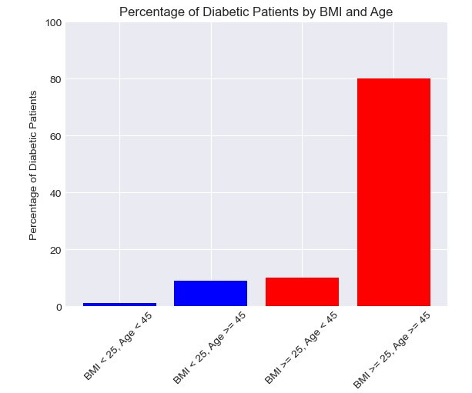
Diabetes by BMI and Age
The majority (80%) were aged 45 and older and had a BMI of 25 kg/m² or higher.
10% were under 45 and had a BMI of 25 kg/m² or higher.
9% were 45 and older but had a BMI below 25 kg/m².
1% were under 45 and had a BMI below 25 kg/m².
Figure 4: Bar chart showing percentage of diabetics
by BMI and age

Slide 11
Conclusion and Implications
Our findings align with established risk factors for Type 2 Diabetes: age 45 or older, overweight (BMI ≥ 25 kg/m²), and physical inactivity (<3 times a week) (CDC, 2022).
Understanding demographic trends in diabetes diagnoses enables targeted interventions tailored to specific populations, emphasizing weight management and lifestyle adjustments due to the strong correlation between obesity (BMI) and diabetes.
These findings underscore the need for multifaceted approaches to diabetes prevention and management, addressing the diverse factors influencing diabetes risk and outcomes comprehensively (Wu et al., 2014).

Slide 12
Limitations
Next Steps
The classification of diabetes types (e.g., type 1, type 2, or gestational diabetes) was not provided in the dataset.
The dataset did not specify the blood glucose level measurement type (e.g., fasting or random blood glucose tests).
Some individuals were excluded from the analysis due to discrepancies in their smoking history labeling.
Development and implementation of comprehensive health promotion strategies encompassing targeted education campaigns, smoking cessation programs, and initiatives focused on managing obesity.
Investigate other potential contributing factors such as alcohol consumption, family history, prediabetes, race, and ethnicity.

Slide 13
References
Centers for Disease Control and Prevention (2022). Diabetes basics. Retrieved from https://www.cdc.gov/diabetes/basics/index.html
Mustafa, M. (2023). Diabetes prediction dataset: A comprehensive dataset for predicting Diabetes with medical and demographic data. Retrieved from https://www.kaggle.com/datasets/iammustafatz/diabetes-prediction-dataset/data
Wu, Y., Ding, Y., Tanaka, Y., & Zhang, W. (2014). Risk factors contributing to type 2 diabetes and recent advances in the treatment and prevention. International Journal of Medical Sciences 6;11(11):1185-200. doi: 10.7150/ijms.10001.

